Slide 1
Logic, Shift, and Rotate instructions
1

Slide 2
Logic instruction
the ability to manipulate individual bits is one of the advantages of assembly language.
bitwise logical operations are performed at bit-by-bit basis.
AND destination, source
OR destination, source
XOR destination, source
NOT destination

Slide 3


AND Instruction
Performs a Boolean AND operation between each pair of matching bits in two operands
AND

Slide 4


OR Instruction
Performs a Boolean OR operation between each pair of matching bits in two operands
OR

Slide 5
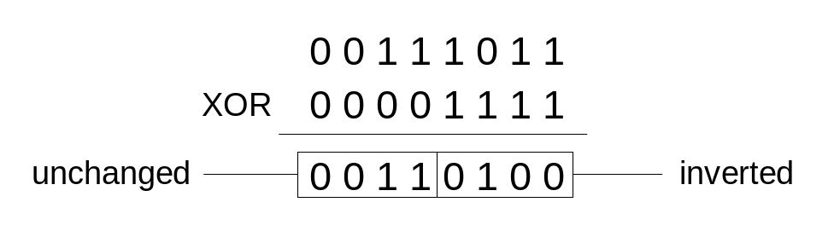

XOR Instruction
Performs a Boolean exclusive-OR operation between each pair of matching bits in two operands
XOR
XOR is a useful way to toggle (invert) the bits in an operand.

Slide 6
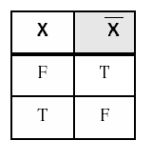
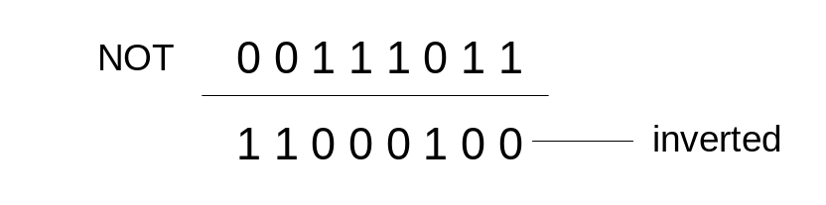
NOT Instruction
Performs a Boolean NOT operation on a single destination operand
NOT

Slide 7
Logic instruction
AND destination, source
OR destination, source
XOR destination, source
The result of the operation is stored in the Destination n, which must be a general register or a memory location. The Source may be an constant value, register, or memory location. The Destination and Source CANNOT both be memory locations.

Slide 8
Logic instruction
Instruction:
AND AH, AL ; --> means: AH = AH AND AL
AH = 01001100
AL = 00101101
--------------------- AND
result = 00001100 (= 12) is stored in AH

Slide 9
Logic instruction
Instruction:
OR AH, AL ; --> means: AH = AH OR AL
AH = 01001100
AL = 00101101
------------- OR
result = 01101101 (= 6Dh) is stored in AH

Slide 10
Logic instruction
Instruction:
XOR AH, AL ; --> means: AH = AH XOR AL
AH = 01001100
AL = 00101101
------------- OR
result = 01100001 (= 61h) is stored in AH

Slide 11
AND, OR, XOR
Effects on Status Flag
Zero flag (ZF), Sign flag (SF), Parity flag (PF) are affected
carry flag (CF) and overflow flag (OF) are cleared.
AF is undefined

Slide 12
AND, OR, XOR / Examples
Clear the sign bit of AL while leaving the other bits un changed.
AND AL, 7Fh ;the mask = 01111111b
Set the most significant and least significant bits of AL while preserving the other bits.
OR AL, 81h ;the mask = 10000001b
Change the sign bit of DX.
XOR DX, 8000h

Slide 13
Converting an ASCII Digit to a Number
For any ASCII digits, bit 4 and 5 of its ASCII code are 11; but for the corresponding decimal digit bit 4 and 5 are 00. The remaining bits are similar:
5d = 00000101, ASCII 5 = 00110101
If the key ‘5’ is pressed, AL gets 35h, to get 5 in AL, we could do:
  SUB AL, 30h
  Or
  AND AL, 0Fh

Slide 14
Clearing a register
A register operand can be cleared to zero using any of the instructions: MOV, SUB, AND, and XOR. The followings are ways to clear any general-purpose register to zero.
MOV AX, 0
SUB AX, AX
AND AX, 0
XOR AX, AX

Slide 15
Clearing a memory location
A memory operand can be cleared to zero using either the MOV or AND instruction. The followings are ways to clear any memory location to zero.
MOV VAR1, 0
AND VAR1, 0

Slide 16
Testing a register for Zero
CMP AX,0
OR instruction can be used to examine whether or not any general-purpose register is equal to zero.
OR AX, AX
ZF is affected and if AX contains 0; ZF=1

Slide 17
NOT Instruction
Performs the one’s compliment operation in the destination:
NOT destination
No effects on the status flags
Example: complement the bits in AX
NOT AX

Slide 18
TEST Instruction
Performs an AND operation but does not change the destination contents:
TEST destination, source
Effects on Status Flag
ZF, SF, PF reflects the result
CF and OF are cleared.
AF is undefined

Slide 19
TEST Instruction
Example
Jump to label BELOW if AL contains even number
Solution:
Bit #0 in even numbers is 0 mask = 00000001b=1
TEST AL,1
JZ BELOW

Slide 20
Shift Instruction
Shifting: The bits are shifted left or right. bits shifted out are lost.
Rotating: The bits shift out of one end of the data are placed at the other end of the data so nothing is lost.

Slide 21
Shift Instruction
Two possible formats:
;for a single shift or rotat
Opcode destination,1
;for a shift or rotat of N positions
Opcode destination,CL
where CL contains N
Destination is an 8-bit or 16-bit register or memory location

Slide 22

Shift Left Instruction
To shift 1 bit to the left we use:
  SHL dest,1
  the msb (most significant bit) is moved into CF (so the previous content of CF is lost) each bit is shifted one position to the left
  the lsb (least significant bit) is filled with 0
  dest can be either byte, word

Slide 23
Left shift instruction
Shifting multiple times to the left:
SHL dest,CL ; value in CL = number of shifts
Effect on flags:
SF, PF, ZF reflect the result
CF contains the last bit shifted from the destination
OF = 1 if the last shift changes the sign bit
(if count more than 1 , OF is undefined)

Slide 24
Example
Suppose DH = 8Ah, CL= 3. What are the contents of DH and of CF after execution of:
SHL DH,CL
DH= 10001010, after 3 left shift:
DH= 01010000 =50h, CF=0

Slide 25
Multiplication by left shift
Each left shift multiplies by 2 the operand for both signed and unsigned interpretations:
AL contains 5= 00000101b.
SHL AL,1 ;AL=00001010b =10d
SHL AL,1 ;AL=00010100b =20d
AX contains FFFFh (-1), CL =3
SHL AX,CL ;AX=FFF8h (-8)

Slide 26
example
Write some code to multiply the value of AX by 8. Assume that over flow will not occur.
Solution:
MOV CL,3 ;number of shifts to do
SAL AX,CL ;multiply by 8

Slide 27

Right shift instruction
To shift to the right use:
  SHR dest, 1
  SHR dest, CL ;value of CL = number of shifts.
  The effect on the flags is the same as for SHL.

Slide 28
Example
Suppose DH = 8Ah, CL= 2. What are the contents of DH and of CF after execution of:
SHR DH,CL
DH= 10001010, after 2 right shifts:
DH= 00100010 =22h, CF=1

Slide 29

The SAR instruction
The shift arithmetic right operates like SHR, with one difference. The MSB retains its original value.
SAR des,1
SAR des, CL
The effect on flags is the same as SHR.

Slide 30
Division by right shift
A right shift might divide the destination by 2, this is correct for even numbers. For odd numbers, a right shift halves it and rounds down to the nearest integer.
Ex: if BL = 00000101b =5d
After SHR BL,1
BL = 00000010=2d

Slide 31
Signed and unsigned division
If an unsigned interpretation is being given, SHR should be used.
If a signed interpretation is being given, SAR should be used, because it preserve the sign.

Slide 32
example
Use right shifts to divide the unsigned number 65143 by 4. put the quotient in AX.
Solution:
MOV AX, 65143
MOV CL, 2
SHR AX, CL

Slide 33
example
If AL contains -15, give the decimal value of AL after SAR AL,1 is performed.
Solution:
-15d= 11110001b
After shifting :
11111000b=-8d

Slide 34

Rotate left
Shifts bits to the left. The MSB is shifted into the rightmost bit. The CF gets the bit shifted out of the MSB.
ROL des,1
ROL des, CL

Slide 35

Rotate right
Shifts bits to the right. The Right Most Bit is shifted into the MSB bit. The CF gets the bit shifted out of the RMB.
ROR des,1
ROR des, CL
We can use ROL and ROR to inspect the bits in a byte or word, without changing the contents.

Slide 36
example
Use ROL to count the number of 1 bits in BX, without changing BX. Put the answer in AX.
Solution:
XOR AX,AX JNC next
MOV CX,16 INC AX
top: next:
ROL BX, 1 LOOP top

Slide 37
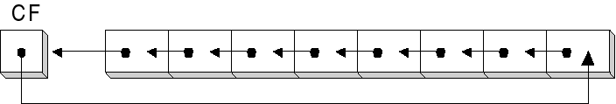
Rotate carry left
Shifts the bits of the destination to the left.
The MSB is shifted into CF, and the previous value of CF is shifted into the rightmost bit.
RCL des,1
RCL des,CL

Slide 38
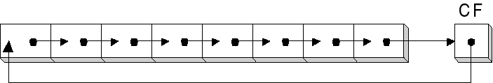
Rotate carry right
Shifts the bits of the destination to the right.
The Right Most Bit is shifted into CF, and the previous value of CF is shifted into the MSB bit.
RCR des,1
RCR des, CL

Slide 39
example
Suppose DH = 8Ah, CF = 1, and CL=3
what are the values of DH and CF after
RCR DH, CL
Solution:
CF DH
initial values 1 10001010
after 1 0 11000101
after 2 1 01100010
after 3 0 10110001

Slide 40
Effect of the rotate instructions on the flags
CF = last bit shifted out
OF = 1 if result changes sign on the last rotation. (if count more then 1, OF is undefined)

